Slide 1


Project name: Benchtop Environment Sensor Tester (BEST) Team members: Binkley, Weston; Livingston, Tyler; Pahwa, Samarth

Slide 2
Project description
Problem statement: “Sandia National Laboratories would like a consistent, reliable way to ensure that environmental sensors are working. These sensors measure temperature, air pressure, and acceleration.”

Slide 3
Project description
Solution proposal: “Create three electronically controlled environments to separately test accelerometers, thermocouples, and pressure sensors by comparing data against the actual conditions of the environment.”

Slide 4
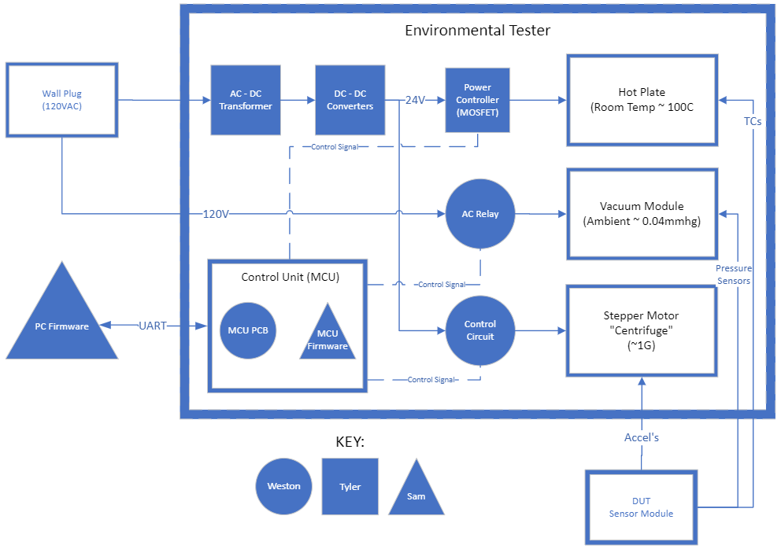
Subsystem Overview

Slide 5
Power Subsystem
Completed:
PCBs Ordered
36V to 24V 9.2A
36V to 12V 0.33A
12V to 5V 0.5A
Low-Side FET Driver
To Do:
PCB Assembly
Validation / Testing

Slide 6
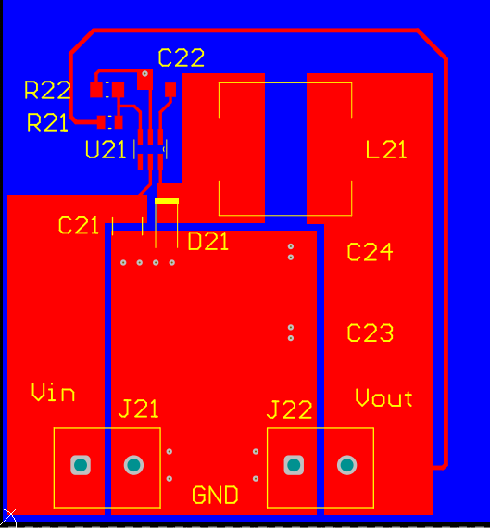
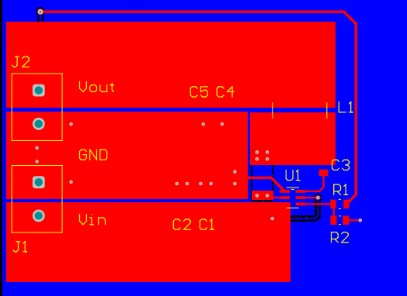

Slide 7
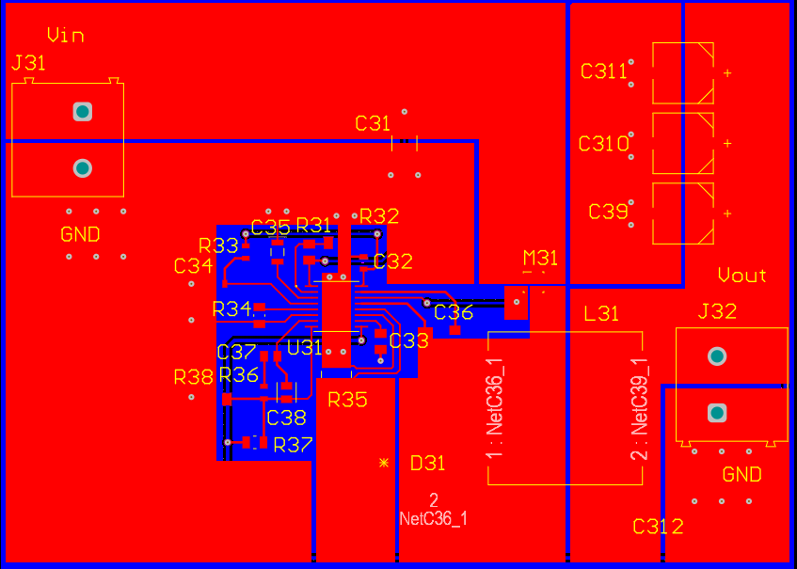
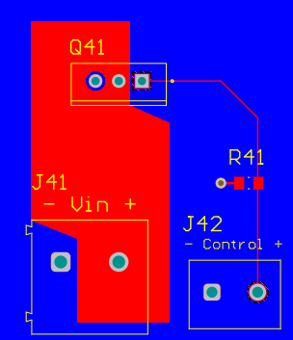

Slide 8
Planned Validation

Slide 9
Firmware Subsystem
Completed:
Basic PC App developed for basic stepper motor control
Created closed loop system for environments
To Do:
Create functioning PID control system for 3 environments
Create fully functioning PC app

Slide 10
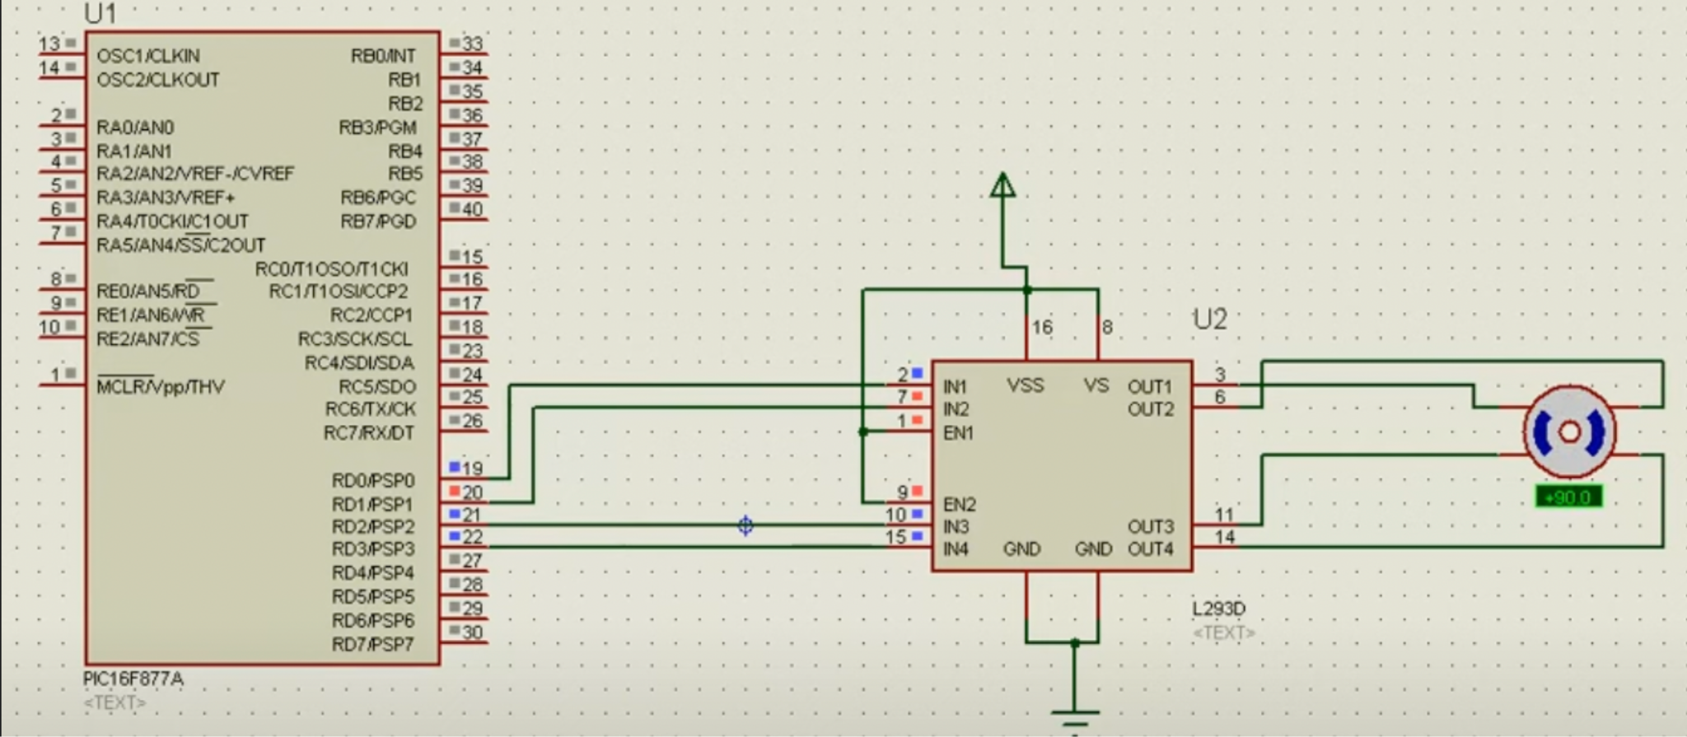
Stepper motor

Slide 11
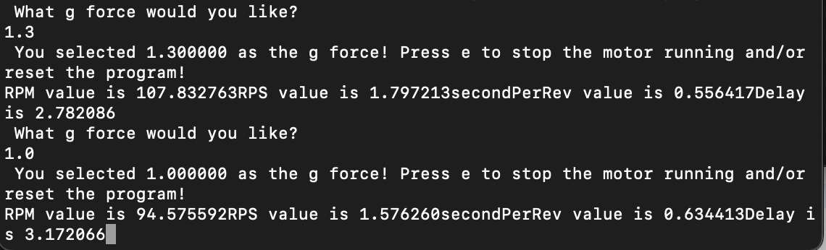

Slide 12
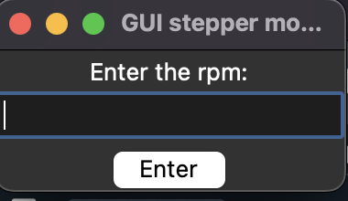
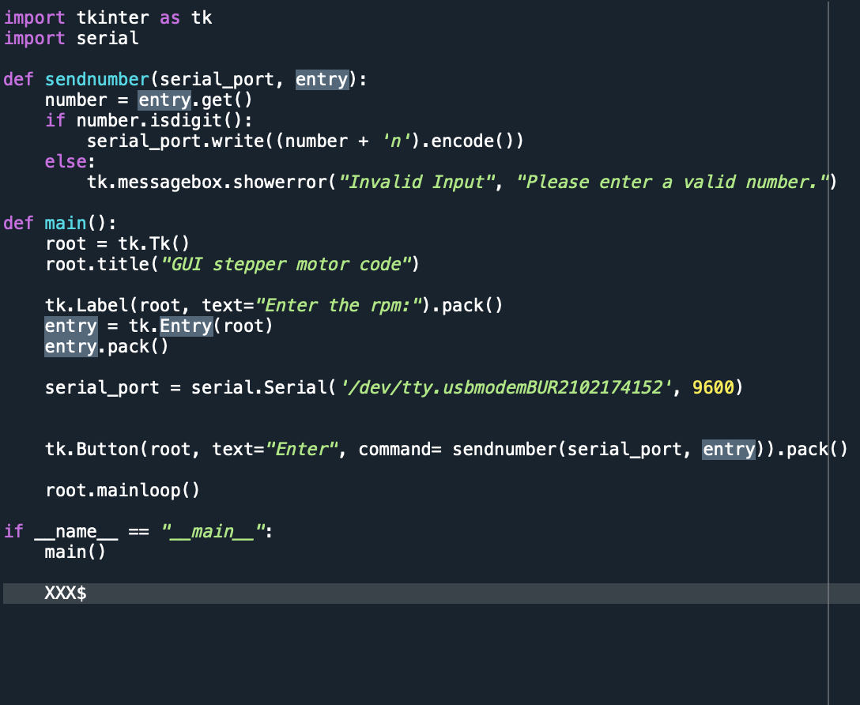

Slide 13
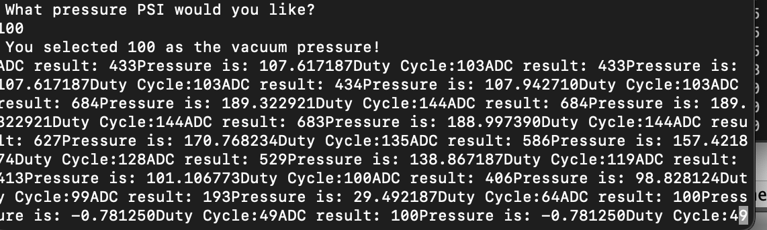
Vacuum chamber

Slide 14
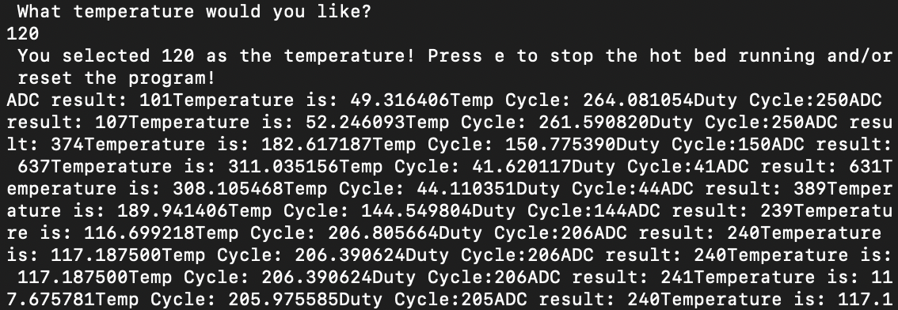
Hot bed control

Slide 15
Validation plan
Ensure that output signals for Pwm are generated
Ensure that PID system does not lead to errors

Slide 16
Electronics Subsystem
Completed:
Selected feedback sensors
Designed control circuitry and MCU interface
Conducted a design review
Ordered PCBs
To Do:
Assemble PCBs
Begin testing and debugging

Slide 17

Electronics Subsystem
Air pressure sensor
120V AC Relay
PC Application
Stepper Motor Driver
PicKit Programmer
Accelerometer
Hot Plate Driver
Thermistor

Slide 18
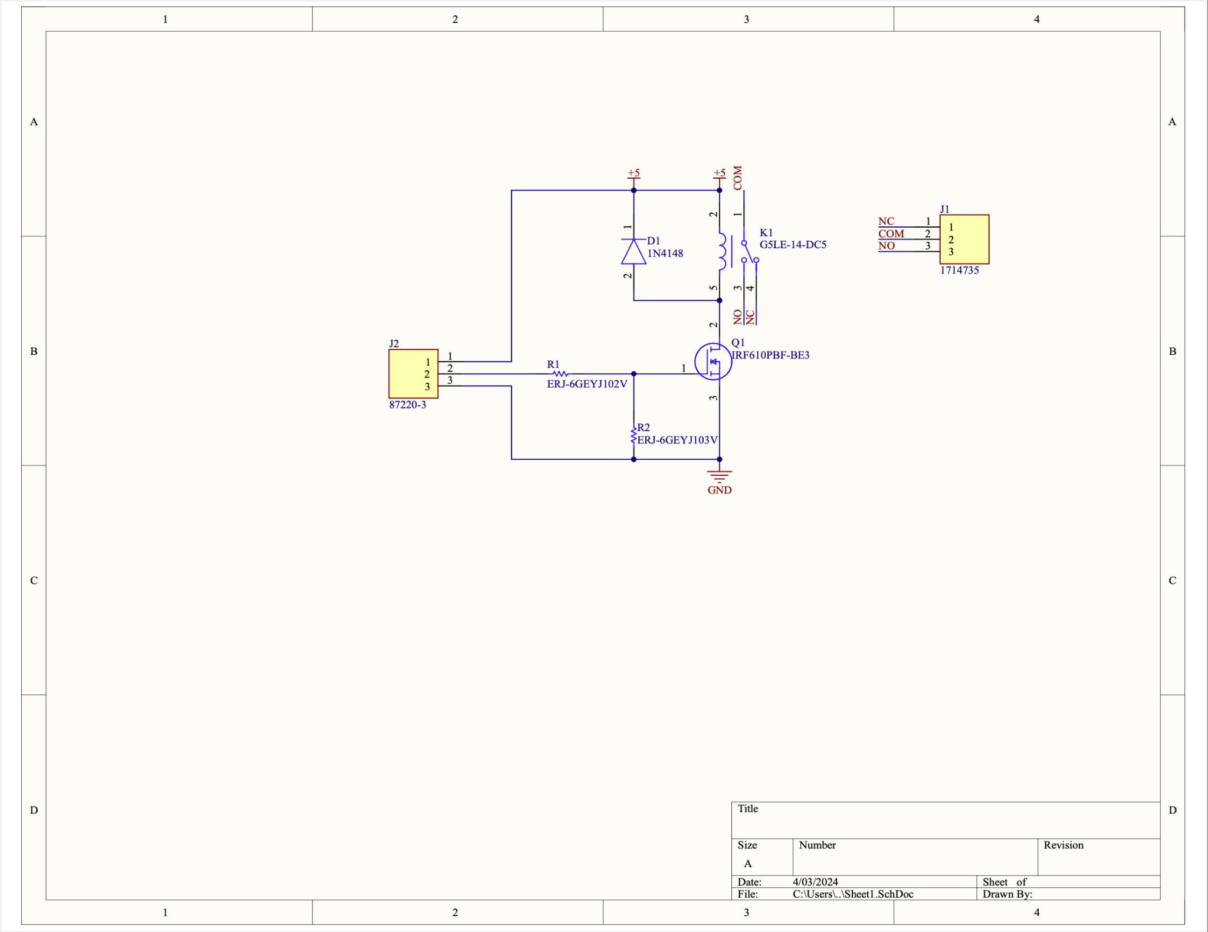
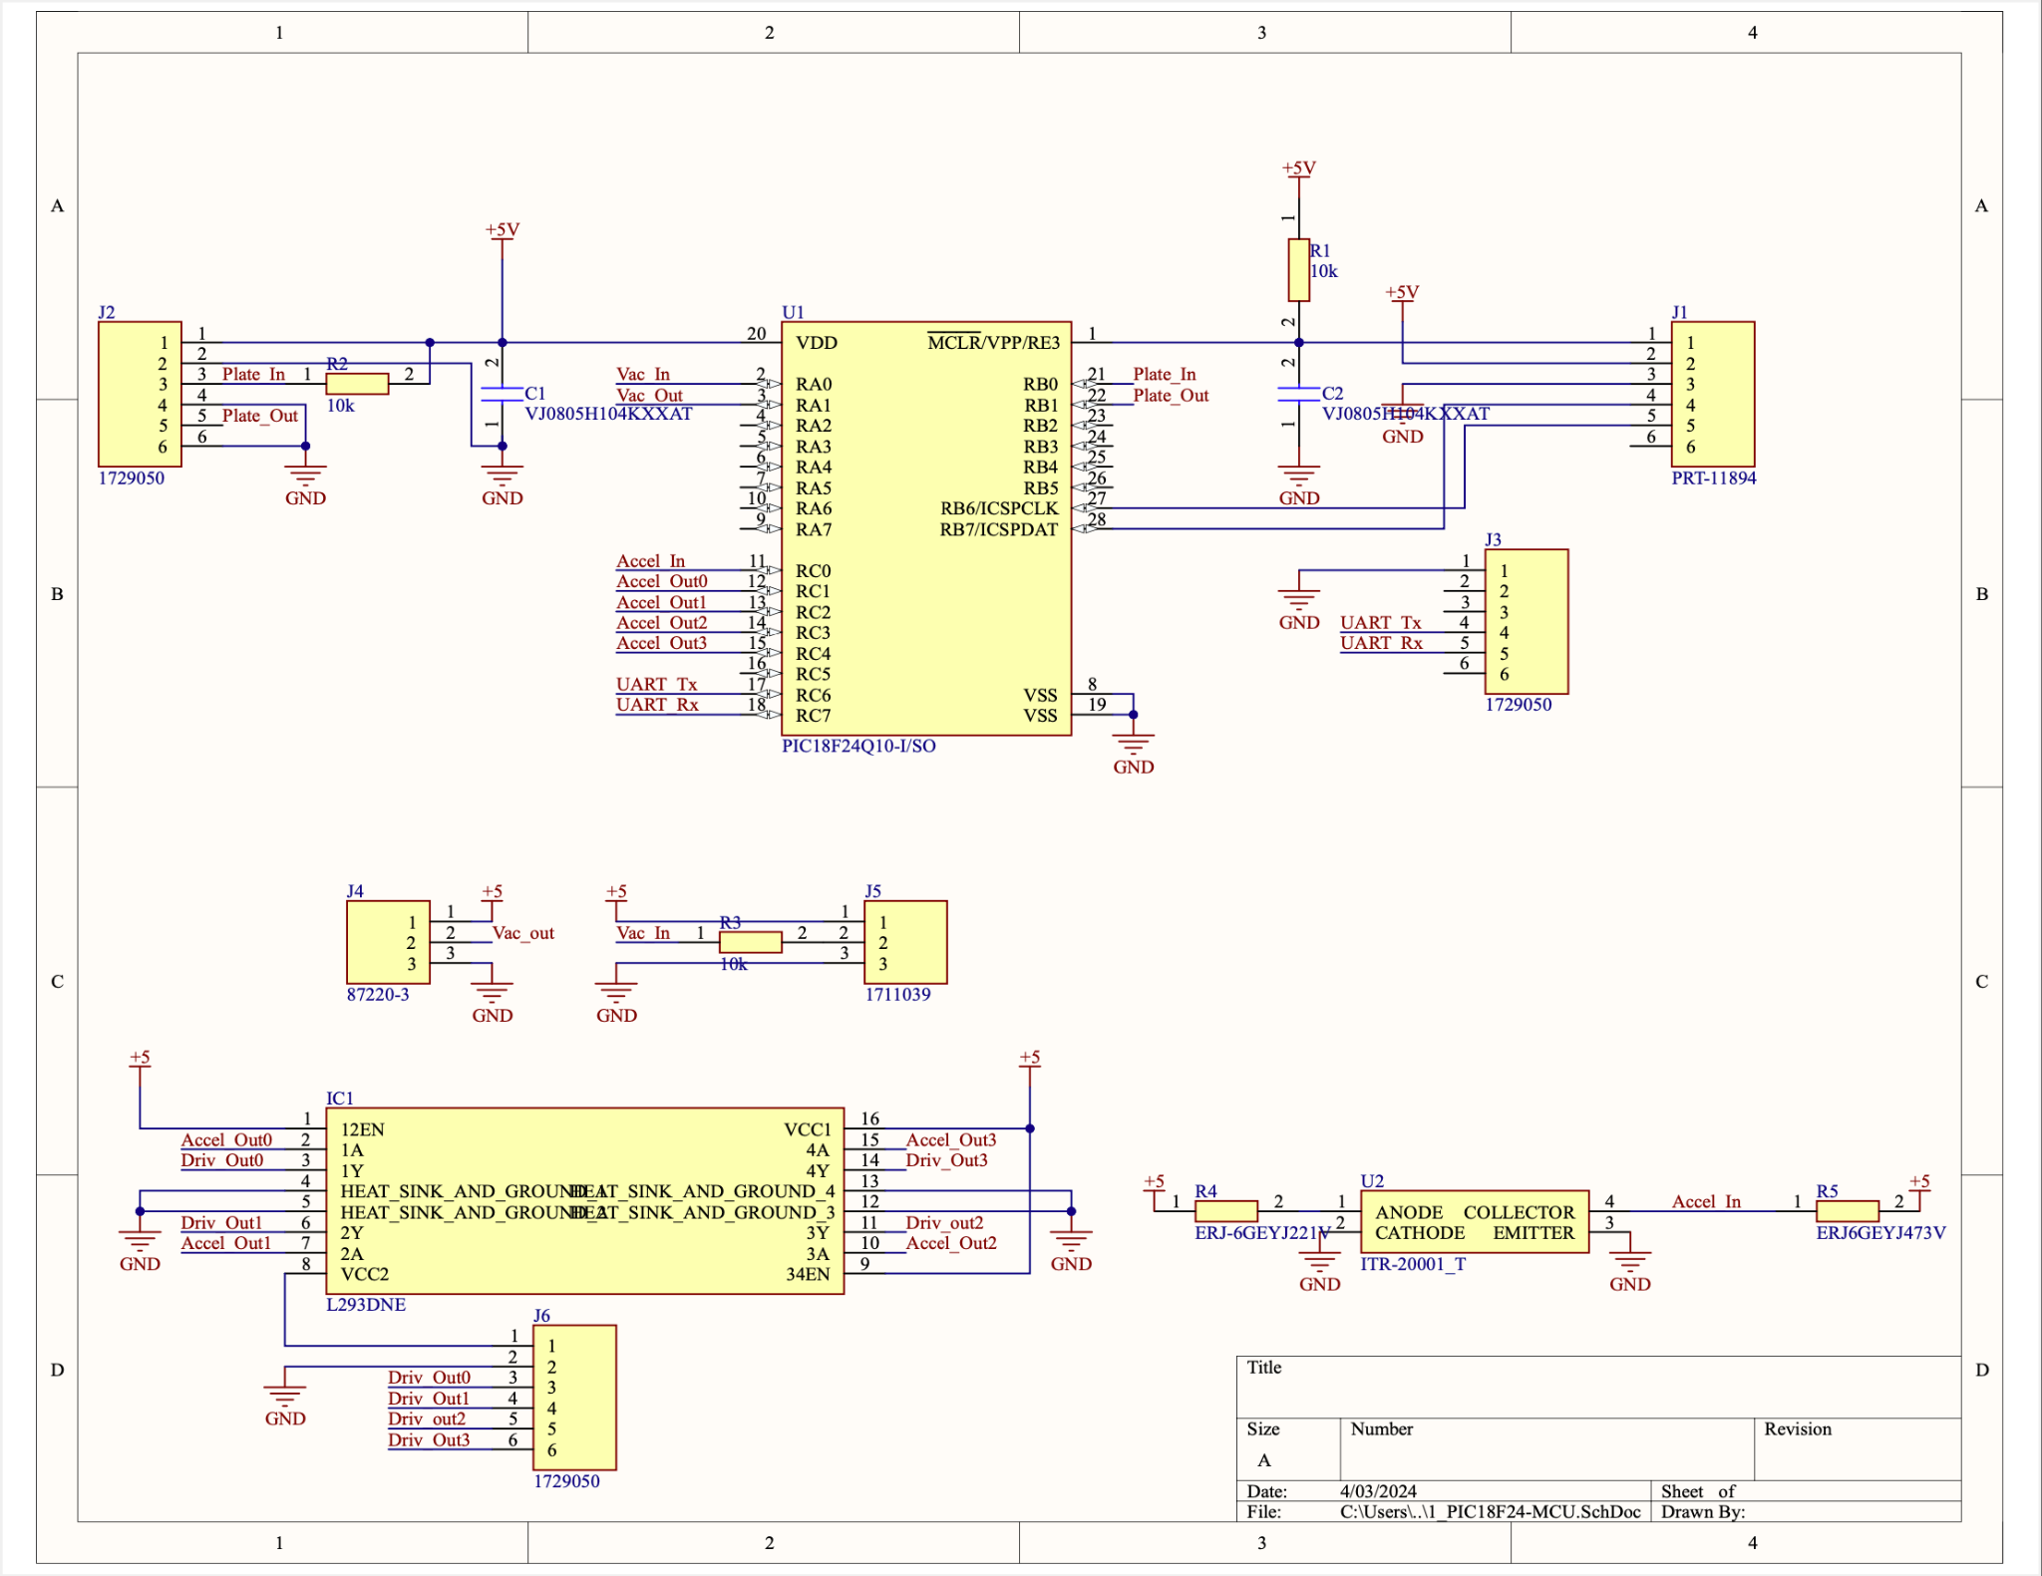

Slide 19
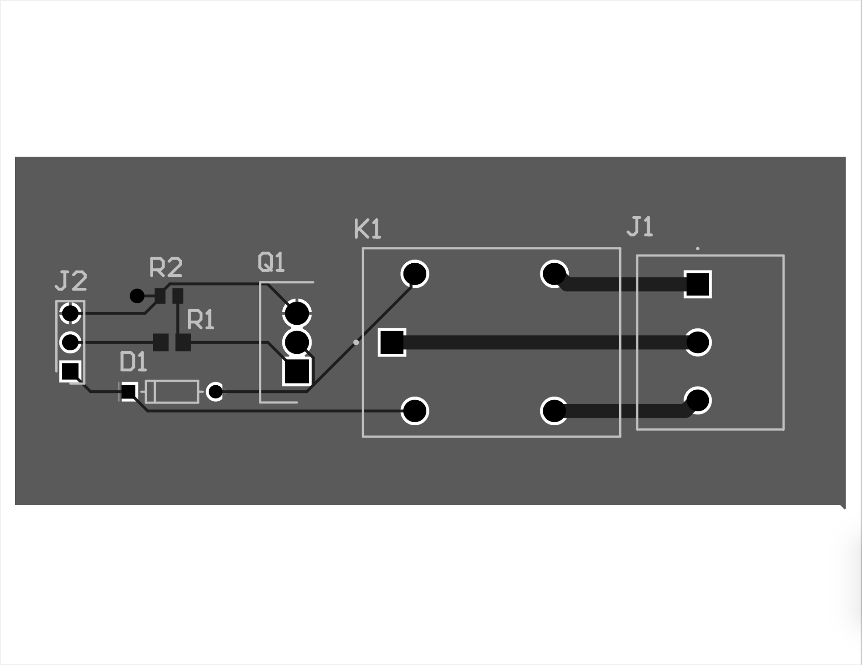

Slide 21
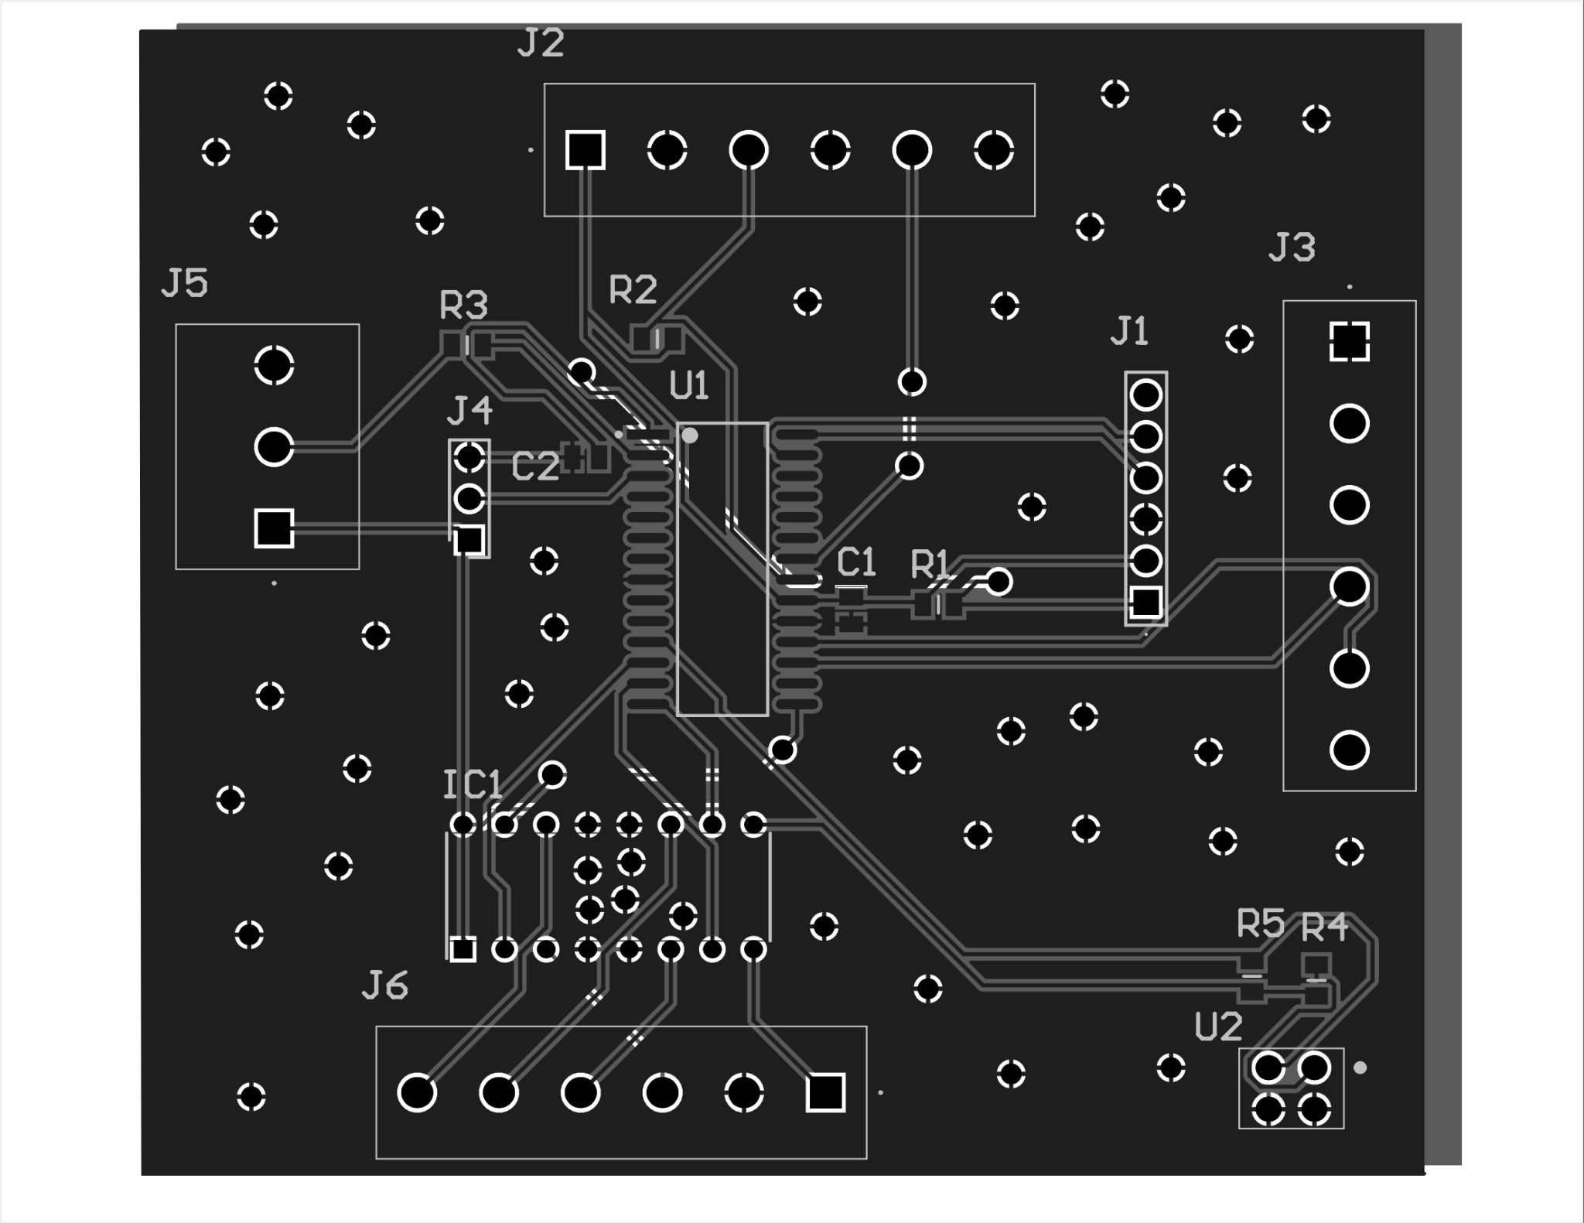

Slide 22
Electronics Subsystem
Validation Plan:
Ensure that the relay can safely switch 120VAC
Use ICSP to load firmware onto MCU board
Run a “hello world” program with measurable outputs on MCU board

Slide 23
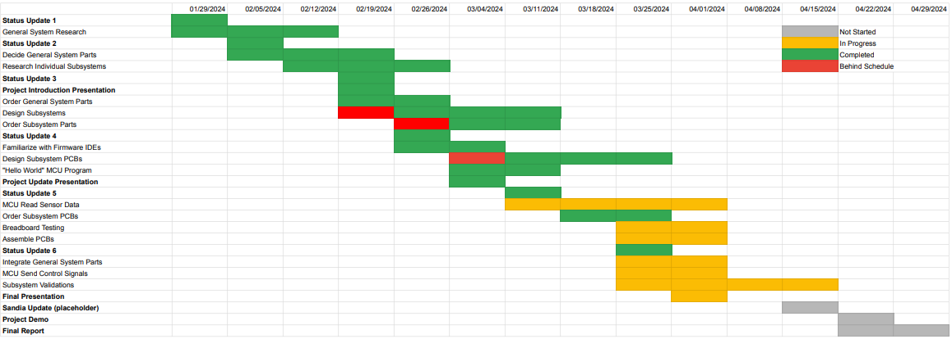
Execution Plan

